Slide 1





Youtube Song Analysis
Presented By:
Soumik Paul

Slide 2




Statement of Problem
Utilizing Power BI, this course work seeks to provide a thorough study of YouTube song data. Important characteristics included in the dataset are the following: video ID, channel title, outline, labels, released date, view count, like count, favorites count, comment count, video time frame, video definitions, and caption details.
Notes:
Effective data visualizations and reports providing an improved comprehension on YouTube songs' how they perform, recognition, including popularity among viewers are to be produced using Power BI. In order to help consumers and content providers optimize the performance of their YouTube music content, the analysis looks for patterns, tastes, and trends in the data.

Slide 3
O B J E C T I V E S
Preparation and Cleaning of Data
Exploratory Data Analysis
Processing as well as clean the dataset, taking care of any outliers with values that are absent. Convert pertinent rows to the right kinds of data.
Examine the views, likes count, along with comments for patterns in addition to distributions. Determine patterns within the usage and recognition of music videos on YouTube.
Channel and Content Analysis
Examine how videos are distributed among various channels.Determine which tags are popular and how many views they receive.

Slide 4

O B J E C T I V E S
Temporary Trends
Insights of User Engagement
Examine the changes in stats for YouTube music videos throughout time.Determine the best times to publish and how that affects reader engagement.
Examine the connections between views, comments, and likes. Determine the elements affecting viewers' interaction with music videos on YouTube.

Slide 5

Description of Data
1
Video_id: Unique identifier for each YouTube video.
2
Channel Title: Title of the YouTube channel publishing the song.
3
Title: Title of the YouTube song video.
4
Description: Description provided for the YouTube song video.
5
Tags: Tags associated with the YouTube song video.
6
Published At: Date and time when the YouTube song video was published
7
ViewCount: Number of views received by the YouTube song video.
8
Like Count: Number of likes received by the YouTube song video.
9
Favorite Count: Number of times the YouTube song video has been marked as a favorite.
10
Comment Count: Number of comments posted on the YouTube song video.
11
Duration: Duration of the YouTube song video.
12
Definition: Video definition or quality (e.g., HD, SD).
13
Caption: Availability of captions for the YouTube song video.

Slide 6
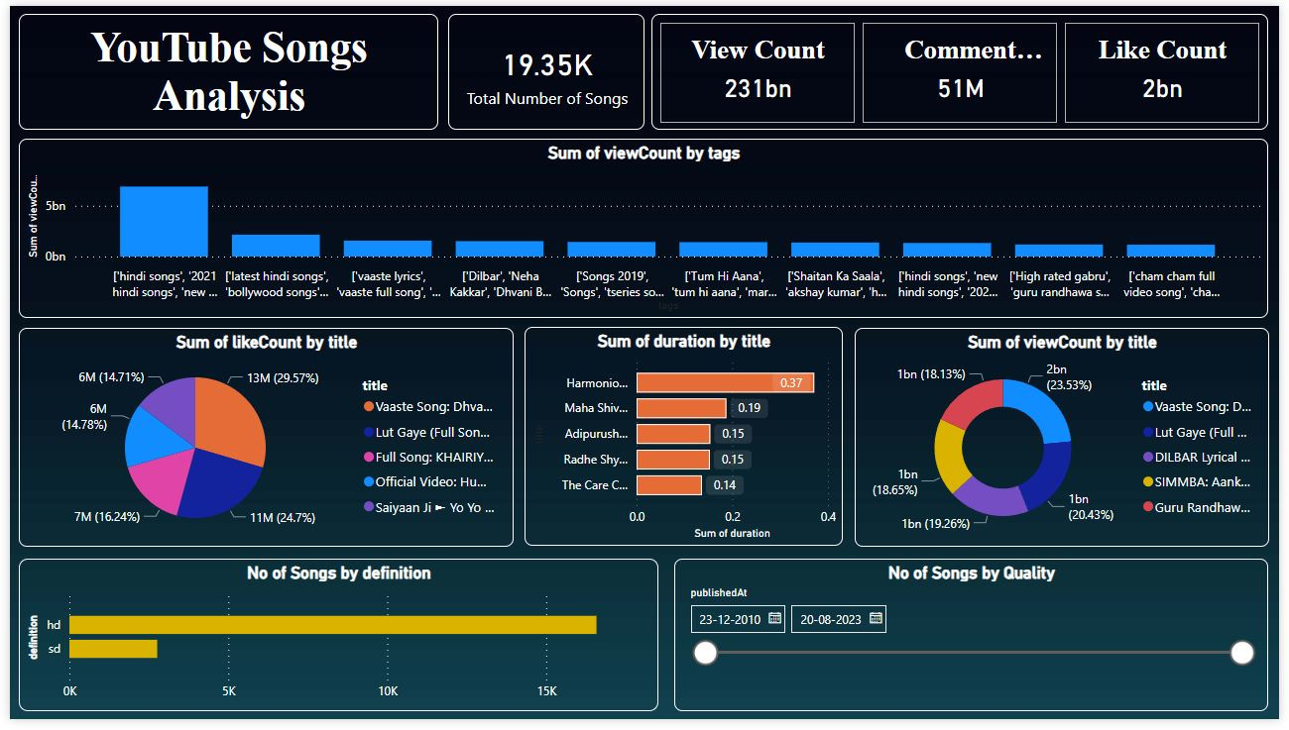

Slide 7





Recommendations
Encourage viewer participation by starting dialogues and responses.
Improve description as well as titles by including relevant keywords.
Use applicable tags to increase your presence in searches.

Slide 8



Thank
You

